Slide 1
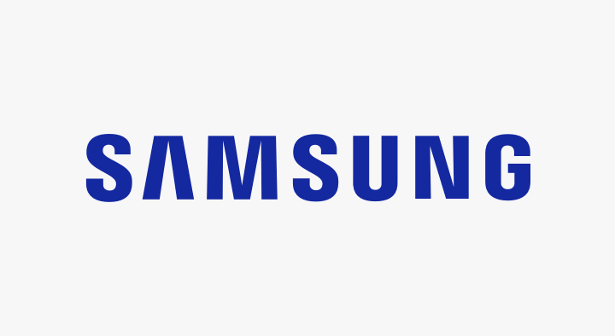
USER GUIDE
SM-N9600

Slide 2
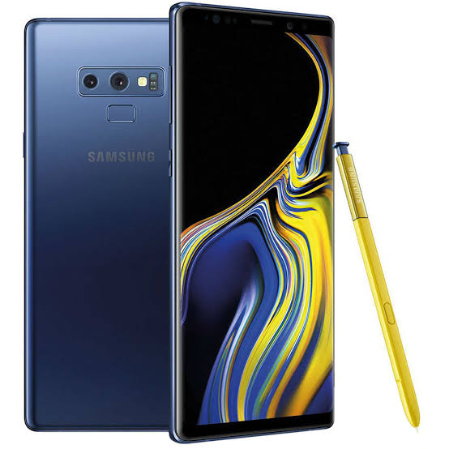
Samsung Galaxy Note 9 is the answer to your desire for a phone that can do much more.

Slide 3
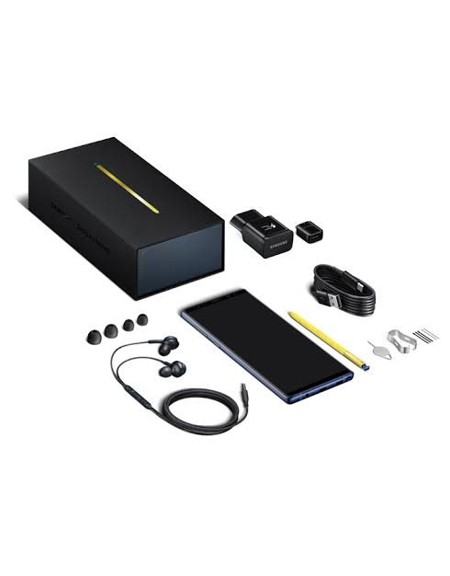
Box Content
Phone
USB Charger
Ear phone
Ear tips (big and small)
Pen nibs
USB cable
Ejection pin
USB micro connector
USB On-The-Go
Tweezers
Case
Quick start guide

Slide 4
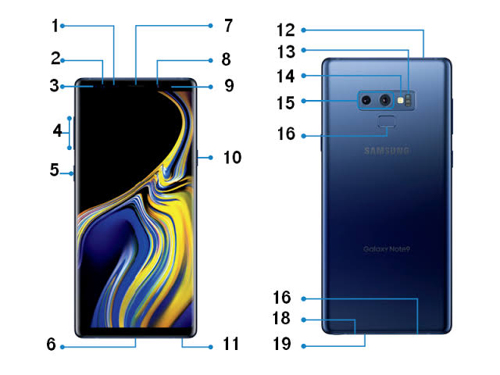
Phone Layout
Proximity light censor
Iris recognition led
Led indicator
Volume key – up and down
Bixby Key
USB charger port
Speaker
Front camera
Iris scanner
Power key
S pen
SIM and Memory card tray
Heart rate censor
Flash light
Dual back camera
Finger print scanner
Ear phone port
Speaker
Microphone

Slide 5
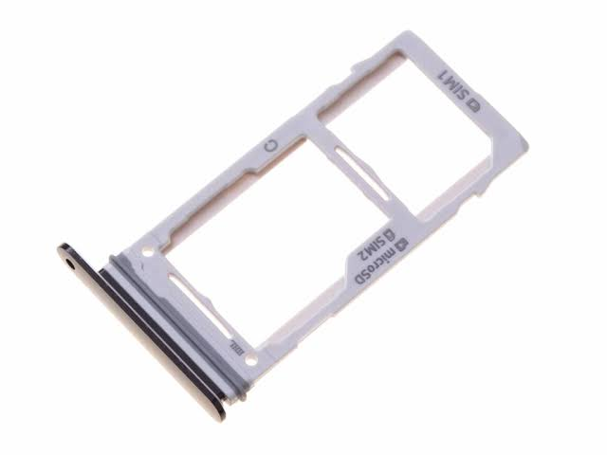
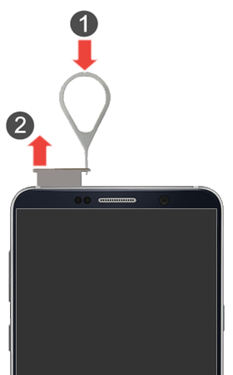
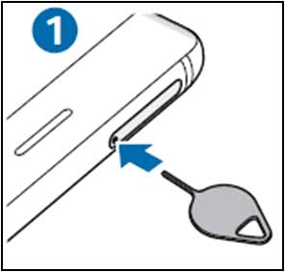
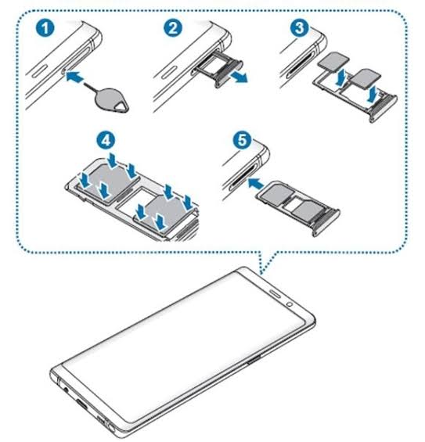
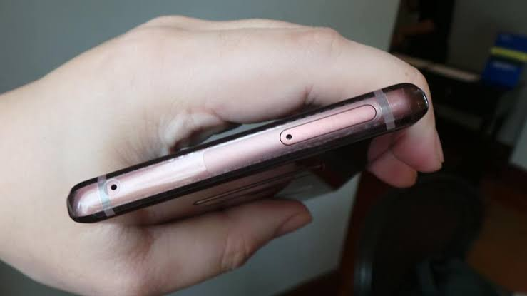
How to Insert SIM and Memory Card
Nano SIM Card
Memory card
Pin hole
Ejection Pin
This tray holds the SIM and memory card . Only Nano SIM card can be inserted into the tray. The tray holds both Nano SIM and memory card.
To insert SIM and memory card, draw out tray with the ejection pin. To do this, insert the ejection pin into the pin hole, doing so, the tray pops out.
Tray
Place SIM on the small space on the tray and memory card on the big space. Then gently insert tray back into its slot.
Make sure the cards are well fitted into the specified space to avoid them from falling off or shifting from the tray. Before inserting tray, make sure the edge of the tray is well aligned with the hole. The tray can only take a SIM Card. Do not insert broom stick into the pin hole.

Slide 6
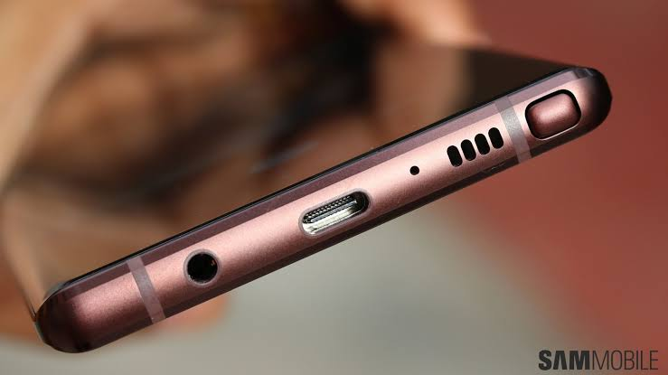
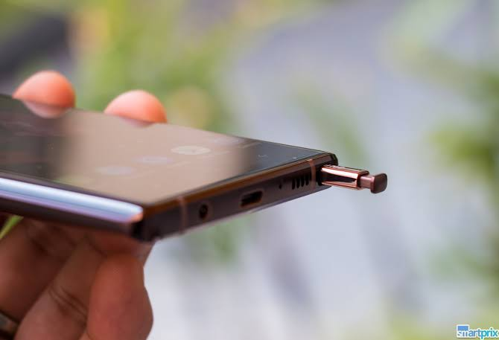
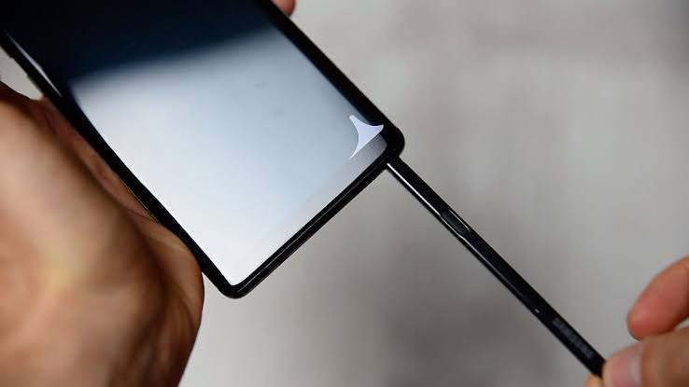
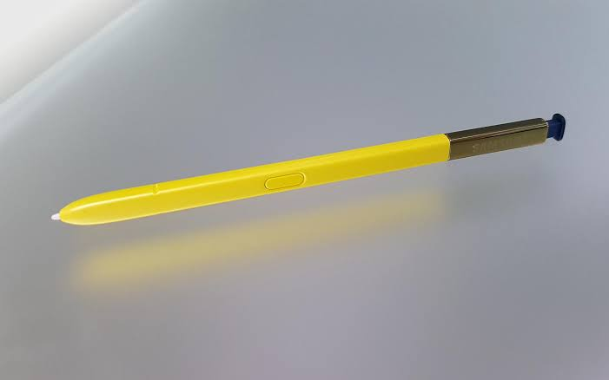
How to Use the S Pen
S Pen
Gently push S Pen
S Pen pops out after push
Draw out pen
S Pen
The S Pen is at the bottom of the phone beside the speaker. Gently push the pen with your thumb and the pen pops out. Hold the pen with your fingers and draw out. To insert the pen back into the hole, gently put the tip of the pen into the hole and push in.
S Pen is used has a remote control to navigate through the app and also has a writing or drawing tool. To activate , with the pen, tap on the Settings app, tap on Advanced features, then tap S Pen and tap S Pen remote; draw switch to the right to On.
To snap a photo, press the button on the pen once ; to change from front camera to back camera, press the button twice.
Press the button on the S Pen once to pause a video and music player and press twice to change to the next video or song.
On the recording app, record and pause with a press of the button.
During presentation, press the button once to move to the next slide, press twice to return to the previous slides.
To unlock screen with S Pen, first set a preferred screen lock (pattern, pin or password), then go to settings, tap Advanced features, tap S Pen, select Unlock with S Pen remote, and tap OK. To unlock screen, press the button on the S Pen once.

Slide 7
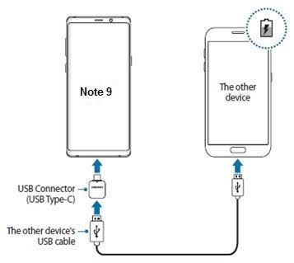
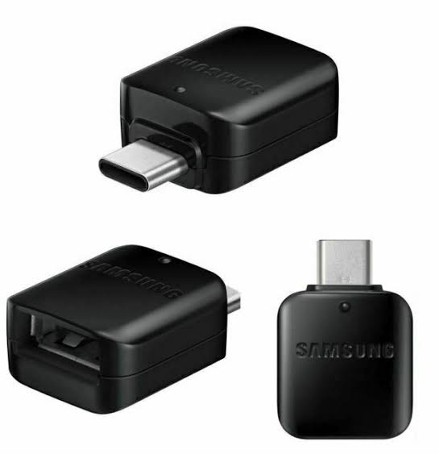
How to Use the USB On-The-Go (OTG)Type-C
Use USB On-The-Go (OTG) connector to transfer data from Note 9 to another device.
Insert other device’s USB cable into USB OTG Connector and insert the connector into the phone’s USB port.
.
USB OTG
The USB On-The-Go Type C Connector can be used with USB-A, USB-B, USB Micro-B and other USB connectors. Connect with a USB 3.01 device for fast transfer of data up to 10 gits per second. While connected to another device, Samsung Note 9 charges the connected device.

Slide 8
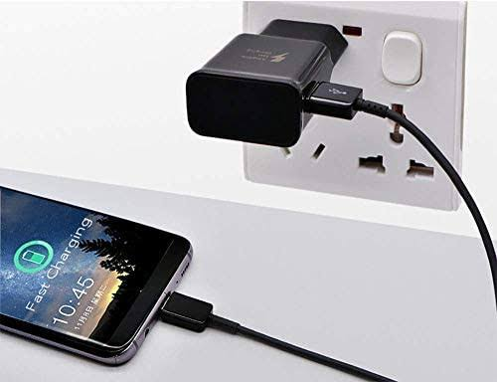
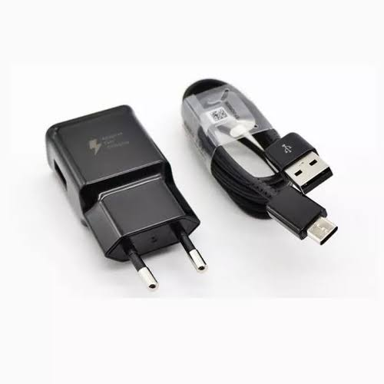
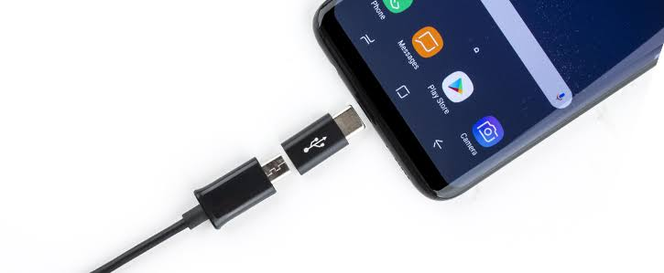
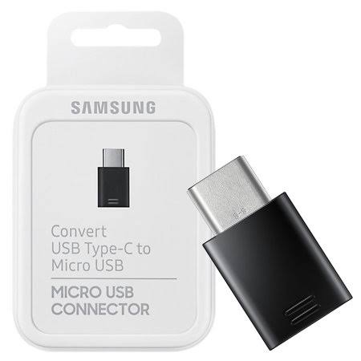
Charge Battery
Samsung Galaxy Note 9 uses a Type C USB cable. The USB port is located at the bottom of the phone.
The Micro USB Connector can be used with USB-A, USB-B, USB Micro-B and other USB connectors. To connect:
Insert USB to micro USB connector, then insert the connector to the phone.
Plug charger to socket to charge battery.
USB C power delivery is about 20 volts, 5 amps and 100 watts for charging. DO not try to insert a lesser USB type into the phone’s USB port; this will damage the USB port. Reason that, the USB port is designed to suite USB Type C only, also all the USB types come in different shapes.
Phone Charger and USB Type C Cable
USB Type B
Micro USB Connector Type C
USB Port
lkl

Slide 9
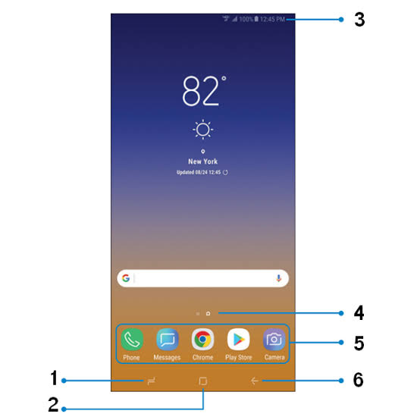
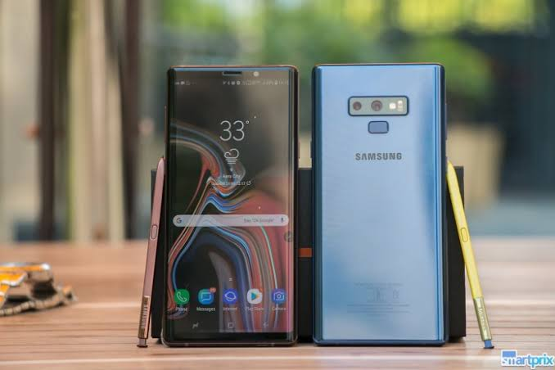
How to Operate Phone
Recent opened apps key
Home key
Time Display
Widget
Home screen applications
Back/return key
To operate phone, press down the power button at the left side of the phone.
When device is turned on, the home button appears at the bottom of the screen as a soft key, gently click for full home screen display.
When phone screen is off, press down the home button till the phone vibrates. Immediately it vibrates, screen turns on.
Lock and unlock screen with a press on the power key.
To turn phone off, press down the power key till the screen shows Power off, Restart and Emergency Mode, tap Power Off. To turn on, press down the power key till the phone vibrates; the screen turns on after the vibration.
For more information;
Go to Settings app and tap User Manual
Visit www.samsung.com/hk

Slide 10
CAUTION
Protect phone from physical damage.
Only use manufacturer approved batteries, chargers and accessory.
Do not expose phone USB port and battery terminals to water and other conductive elements.
Keep phone off when battery compartment is open.
Use a screen guide or protective case to protect phone screen.
Keep phone away from fire and hot environment.
Do not expose phone screen to the sun.
Unplug phone immediately after full charge.
Do not point flash light into the eyes of people and animals.
Keep phone and cable from children.
When phone is faulty or cracked, take to Samsung Service Centre as soon and possible. Keep away from third party.
Do not insert broom stick or other objects asides the ejection pin into the pin hole.
Prevent use of excessive sound pressure from ear phone.
Do not deep device in fresh water deeper that 1.5 m and longer than 30 minutes. Use fresh water only.
Prevent device from salt water, ionized water, alcoholic beverage etc. These liquid will enter the device faster.
When exposed to fresh water, dry phone thoroughly with a clean soft cloth. If phone is exposed to other liquid, immediately rinse off with fresh water and dry thoroughly with a clean soft cloth to prevent phone from malfunctioning.
Do not charge phone when it is wet.
Prevent water from getting to the surrounding of the phone when charging.
Do not use a damaged cable.
Phone battery is explosive. Do not burn or throw into fire.

